Slide 1

ENGLISH PREMIER LEAGUE Big Data Analytics Project Presentation

Slide 2
Know about EPL and data.
Tasks and techniques used
Questions and Analysis Interpretation
Conclusion
Agenda

Slide 3
Video
https://www.youtube.com/watch?v=Vn7u0kryBJo

Slide 4
What is English Premier league?
Professional men’s soccer league played in U.K.
Most-watched sports league in the world, broadcast in 212 territories to 643 million homes and a potential TV audience of 4.7 billion people.
Contested by 20 clubs each season. Clubs named after cities of England and Wales.
Teams play 38 matches each (playing each team in the league twice, home and away), totaling 380 matches in the season. Winning club gets 3 points and a draw gets a point for each club, losers 0.
Season starts in august and ends in may every year. No playoffs. Clubs with most points are crowned EPL champions of that particular year.

Slide 5
Tasks
Factors predicting final result of the match (Multi nominal Logistic Regression)
Clustering the referees into Harsh referee and Lenient referee based on the Fouls committed by the teams and Booking Points given by the referee in the matches over the seasons (K means Cluster analysis)
Does the type of Referee (clustered in the above task) play a role in predicting the Final match result? (Multi nominal Logistic Regression)
Impact of B365 result (Table Analysis and Linear Regression)
Does a team that spends more money on its players end up qualifying for Champions League i.e., being in the top 4 teams list on the league table? (Correlation and Bar Graph)
Sentiment Analysis on Top 3 teams of EPL from Twitter official pages

Slide 6
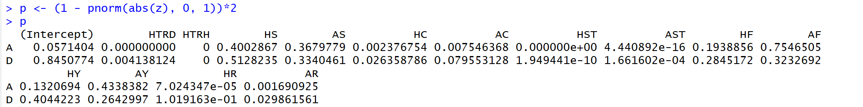

Factors predicting final result of the match (Multi nominal Logistic Regression)
Dependent variable: FTR (Full Time Result)
Independent variables:
Categorical: HTR (Half Time Result)
Continuous: HS, AS, HST, AST, HC, AC, HF, AF, HY, AY, HR, AR
RESULT: HTR, HST, AST, HC, AC, AR are significant factors in predicting Final Match Result.

Slide 7
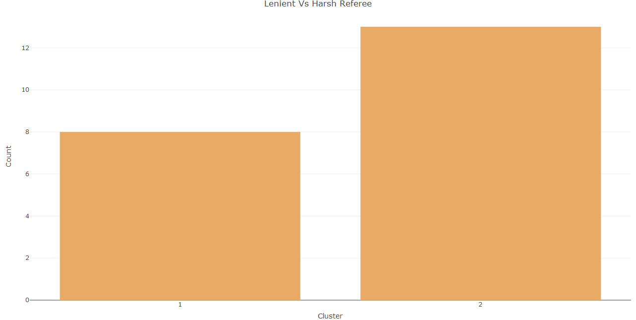
Clustering referees into lenient and harsh
Here, we perform K-means clustering where K is 2 as we require only two clusters
For clustering referees we will consider Fouls, Yellow cards given and Red cards
Formula for booking points = Fouls(0) + Yellow cards(5) + Red cards(25)
Cluster1 consists of Lenient referees and Cluster2 consists harsh referees

Slide 8
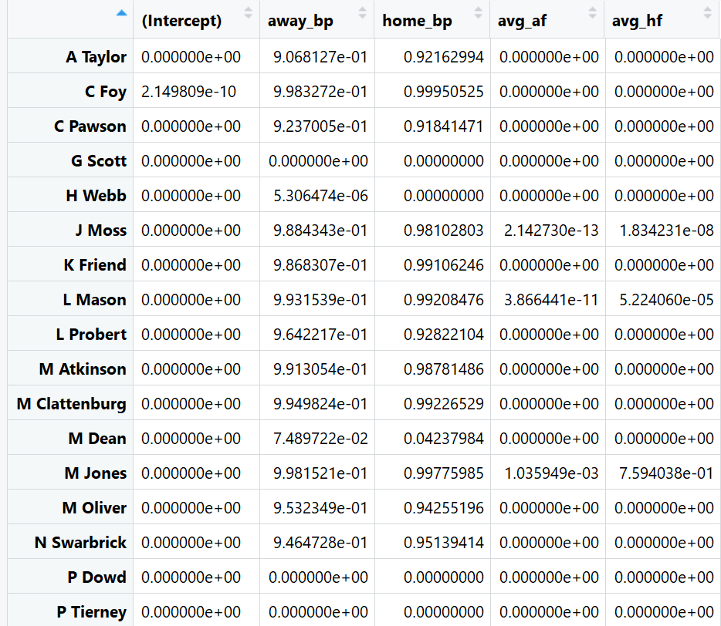
Does the type of Referee (clustered in the above task) play a role in predicting the Final match result?
Multinomial Logistic Regression
Dependent variable: Full Time Result
Independent variable:
Categorical: Half Time Result
Continuous: HST, AST, HC, AC, HR, AY
Formula for booking points = Fouls(0) + Yellow cards(5) + Red cards(25)
We can observe that
Type of Referee clustered above does play a role in predicting the final match result.

Slide 9
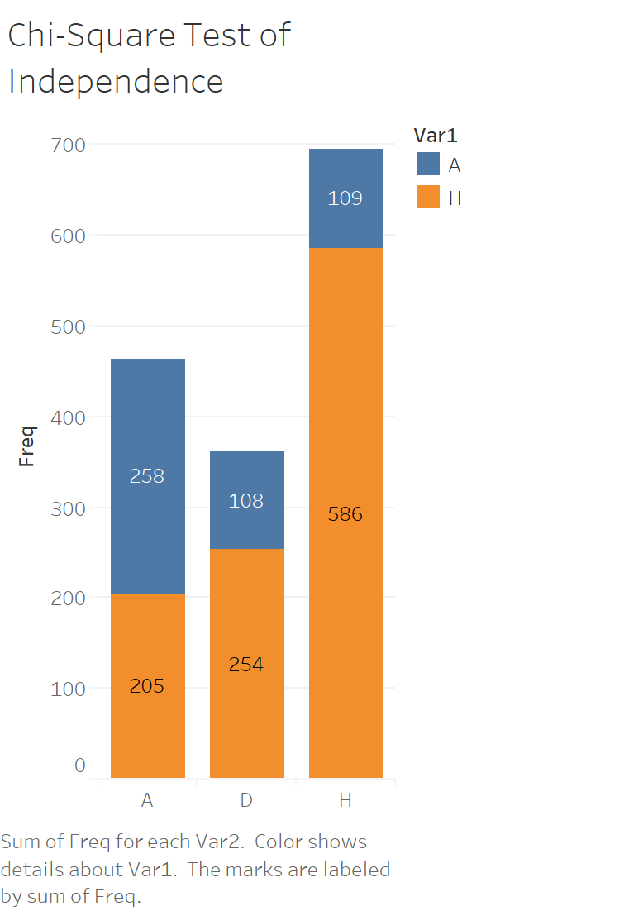
Impact of B365 result (Table Analysis and Linear Regression)
Full Time Result(FTR) – H Home, A Away, D Draw
Results from Table Analysis (Chi-Square):
X-squared = 207.8, df = 2, p-value < 2.2e-16

Slide 10
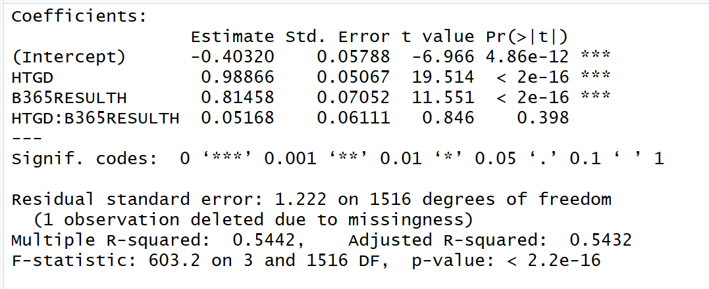
Impact of b365 (Ctd.)
Results from Linear Regression:
Dependent variable: FTGD
Independent variable: HTGD, B365 Result
Moderation: HTGD*B365 Result

Slide 11
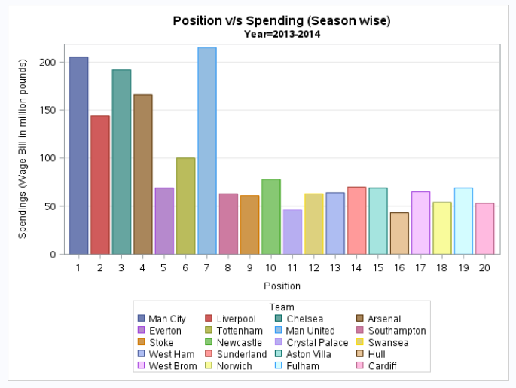
Does a team that spends more money on its players end up qualifying for Champions League i.e., being in the top 4 teams list on the league table? (Correlation and Bar Graph)
Correlation Analysis
Variables: Position, Spendings
Average Correlation is -0.69

Slide 12
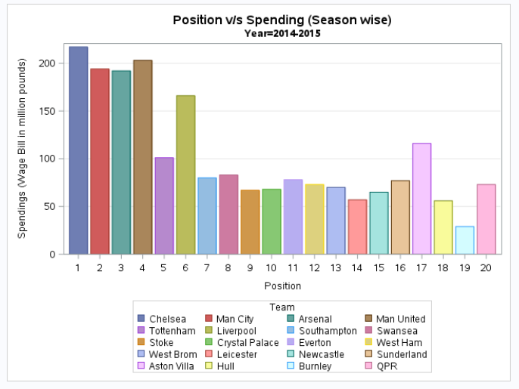
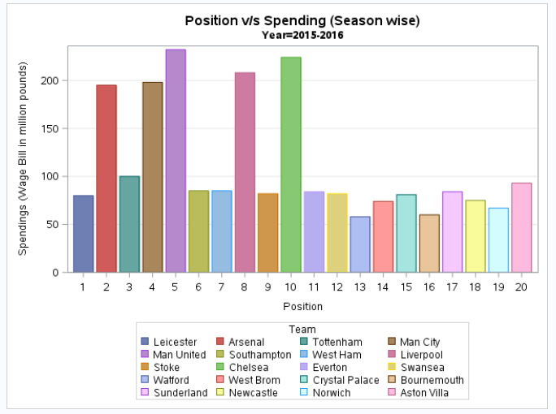
Spending vs position

Slide 13
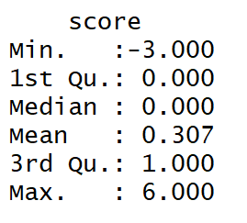
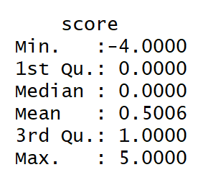
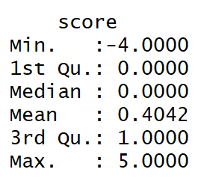
Sentiment Analysis on Top 3 teams of EPL from Twitter official pages
Performing Sentiment Analysis on Manchester United, Manchester City and Liverpool FC twitter
5000 tweets
Sentiment Summary of Manchester United Fans
Sentiment Summary of Manchester City Fans
Sentiment Summary of Liverpool FC Fans

Slide 14
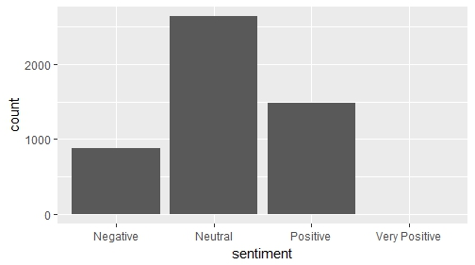
Sentiment Analysis on Top 3 teams of EPL from Twitter official pages
Manchester United Rank : 2
Recent Performance: Win – 2, Lost – 1
Notes:
Fans are neutral because Manchester’s performance improved since last season, but still continues to worry fans

Slide 15
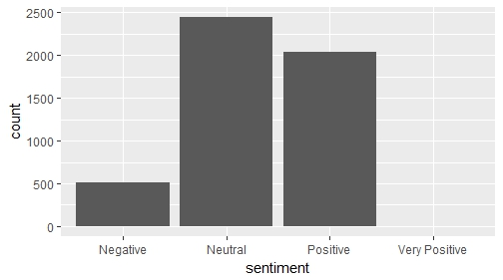
Sentiment Analysis on Top 3 teams of EPL from Twitter official pages
Manchester City Rank : 1
Recent Performance: Win – 1, Lost – 2
Notes:
Fans are positive because Manchester City is in first rank even with recent loses

Slide 16
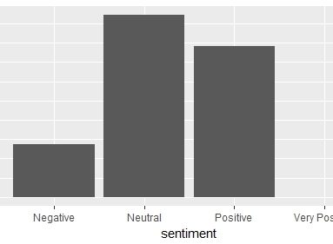
Sentiment Analysis on Top 3 teams of EPL from Twitter official pages
Liverpool Rank : 3
Recent Performance: Win – 2, Lost – 1
Notes:
Fans are positive because Liverpool won on Manchester City which ranks number 1

